Slide 1
QuantaDB
Open Persistent Data Infra Team, Futurewei
Presented by Chun Liu, 1/14/2021

Slide 2
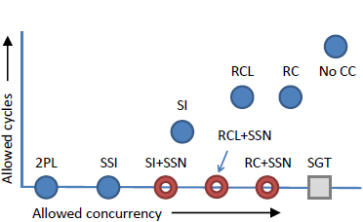
Background
SSN commit protocol
“Efficiently making (almost) any concurrency control mechanism serializable”, VLDBJ, 2017 by TianZheng Wang etc.
“Read Committed” + SSN = Serializable
Allow more scheduling (performance) than 2PL/SSI (Serializable Snapshot Isolation)
Especially with contentious transactions.
Not suitable for distributed deployment:
Assuming single node
Assuming instant state observation via cache coherence protocol.
Spin-lock for multi-threaded validator.
Assuming single clock among cores.

Slide 3
QuantaDB
Fully distributed redesign of SSN, both the sequencer and validator are fully distributed, targeting deployment ranging from rack scale (1us) to geo-distributed (100ms). (DSSN).
Higher performance in throughput and scalability.
Can handle dynamic read and write set in generic workload, unlike deterministic database as CalvinDB.
Disaggregated Compute and Storage – enables deterministic commit/fast local replica read/fast failover. Storage abstraction is PLOG.
Low latency:
Use DSSN to reduce the number of message exchanges for cross-shard transactions.
Use DRAM/PMEM native hash table based key value store for key/metadata access.
Minimize the serial execution window in validator, to maximize validation throughput.
Notes:
Our approach:
Transaction will not block others transaction’s Read/Write operations, even contentious ones. (Contentious transaction will commit in serial).
On a single node, maximize validation throughput via minimizing serial execution window in validator. Single shard transactions can be scheduled with minimal blockage from cross shard transactions.
In a distributed system, leverage SSN to allow more scheduling.
Cross shard transactions will minimize message exchanges, with single trip being the minimal.
Client only need to perform single phase commit.
Can be easily separated from testbed: RAMCloud. Can be easily integrated in other platforms.

Slide 4
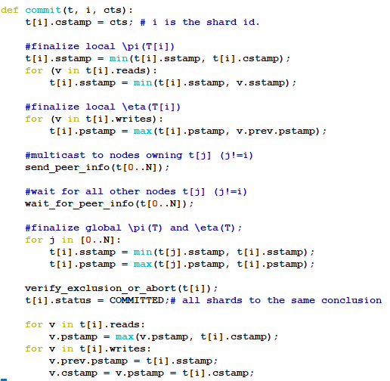
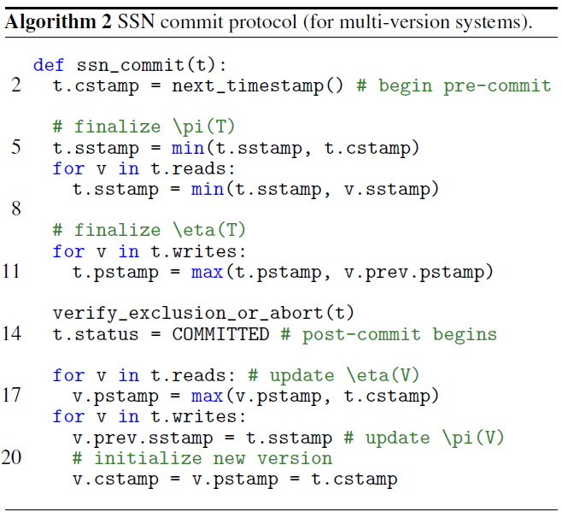
SSN commit vs DSSN commit

Slide 5

Phase 1
Calculate Local η and π
Phase 2
Aggregate final η and π
reorder queue
Validator₁
peer info
exchange
Validator₁
Client X
Coordinator X
LOG
LOG
Sequencer X
Validator₂
Validator₂
Client Y
LOG
LOG
Coordinator Y
Sequencer Y
Validator₃
Validator₃
LOG
LOG
PLOG
PLOG
PLOG
LOG
PLOG
LOG
Notes:
Global loosely synchronized clock in sequencer and validator.
Need to handle transport variable latency and out-of-order-ness.
Persistent abstraction.
SSN -> DSSN
Deterministic commit and failover.

Slide 6
Shards
T_{2 , Sabc}
T_{2, Sabc}
(1)
 | π | η
a
b
c
 | π | η
a | 30 | 10
b | 40 | 20
c | 50 | 30
S_{abc}
T₃
T₁
 | π | η
T_{2, Sabc} | 40 | 30
T_{2, Sxyz} | 42 | 32
 | π | η
T_{2, Sabc} | 40 | 30
LOG
(2)
T₃
T₂
T₁
(4)
 | π | η
T₂ | 40 | 32
(3)
Sequencer
S_{lmn}
l
m
n
l | 31 | 11
m | 41 | 21
n | 51 | 31
T₃
T₁
x
y
z
T_{2 , Sxyz}
T_{2 , Sxyz}
x | 32 | 12
y | 42 | 22
z | 52 | 32
S_{xyz}
T₁
 | π | η
T_{2, Sxyz} | 42 | 32
T_{2, Sabc} | 40 | 30
(2)
 | π | η
T_{2, Sxyz} | 42 | 32
Validators
(4)
 | π | η
T₂ | 40 | 32
(3)
T₁ accesses {a, l, z}, T₂ reads {b, y, z}, writes {c, y}, T₃ accesses {a, c, l},

Slide 7
Client Interface
(t) = BEGIN_TXN()
Read(t, K_{x}, V_{x}) #T reads K_{x} into V_{x}
Read(t, K_{y}, V_{y})
Write(t, K_{l}, V_{l}) #T writes K_{l} with V_{l}
Write(t, K_{m}, V_{m})
Read(t, K_{z}, V_{z})
Write(t, K_{n}, V_{n})
COMMIT_TXN(t)
Read goes to coordinator, then directly to the storage node.
Write is buffered at the coordinator, until the commit.
At commit, the sequencer will generate Commit Time Stamp (CTS), a unique number consist of globally synchronized clock + sequencer id.
{CTS, Read Sets[i], Write Set[i]} are sent to the validator(s) to validate the transaction. All shards involved in the transaction see the same CTS.
If successfully validated, the Write Sets[i] are persisted at home storage node i.

Slide 8
Call Flow
Storage Device A
Storage Device B
Hosting K1, K2
Hosting K3
Client X
Coordinator X
Sequencer X
Validator A
Validator B
id=Begin_TXN()
Read(id, K1)
Read(id, K1)
ReadResp(id, K1, V1, meta1)
Write(id, K2, Val2)
Write(id, K2, Val2)
Write(id, K3, Val3)
Write(id, K3, Val3)
F=Commit_TXN(id)
Commit_TXN(id, K1, Meta1
K2 = Val2, K3=Val3)
cts = GenCTS()
Commit (cts, K1, meta1,K2=Val2)
Delay + Reorder
Commit (cts, K3=Val3)
Log (cts, K1, meta1, K2=Val2)
Delay + Reorder
l_meta= {η , π} * {K1, K2}
Log (cts, K3=Val3)
PeerInfo(cts, l_meta, g_meta)
l_meta= {η , π} * {K3}
PeerInfo(cts, l_meta, g_meta)
res = ValidateTxn(cts, g_meta)
Log(cts, k1, meta1, K2=Val2, res)
res = ValidateTxn(cts, g_meta)
CommitResp(cts, res)
Log(cts, K3=Val3, res)
Res= F.Resolve()
CommitResp(cts, res)

Slide 9
QuantaDB Walkthrough
Build on top of RAMCloud
$RAMCLOUD/src/quantadb
Coordinator:
Adapt the ClientTransactionTask.cc
Enclosed in #ifdef QDBTX
PREPARE state always transit to COMMIT/ABORT decision.
RAMCLOUD
Client
Server
ClientTransactionTask.cc
quantadb/DSSNService.cc
quantadb/Sequencer.cc
quantadb/HashmapKVStore.cc
quantadb/Validator.cc
quantadb/ActiveTxSet.cc
quantadb/DistributedTxSet.cc
quantadb/TxLog.cc
quantadb/…

Slide 10
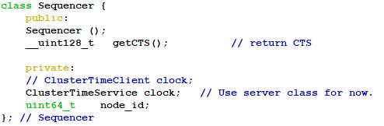
Sequencer
Implemented as a library.
Client call Sequencer API to get a 128-bit CTS.
Upper 64-bits = clock in nanoseconds + delta
Delta represents the expected client-server network latency
Delta is currently hard-coded.
Lower 64-bit = sequencer id.
Interpreted as a fraction of nanoseconds.
Clock: quantadb/ClusterTimeService.h
Sequencer: quantadb/Sequencer.h

Slide 11
Validator.cc
RPC Handler
Scheduling
Thread
Serialize Thread
Peering Thread
InsertTxEntry()
Cross Shard?
Y
reorderQueue.try_pop()
localTxQueue.findFirst()
Sorted by CTS
Reorder window honored
Late CTS rejected.
N
!activeTxSet.blocks(txEntry)
localTxQueue
validateLocalTx(txEntry)
distributedTxSet.add()
reorderQueue
2. Sort & Wait Stage
distributedTxSet.findReadyTx()
activeTxSet.add(txEntry)
txEntry scheduled for PeerInfo Exchange.
1. Receive Stage
3. Serialize Stage
peerInfo.send()
sendSSNInfo()
In the case of missed
peerInfo exchange.
4. Exchange Stage
replySSNInfo()
concludeQueue.try_pop()
Conclude TX
5. Conclude Stage

Slide 12
Validator’s ActiveTxSet
Only Independent Tx can be allowed in serialization window.
Younger Tx depends on Tx in the serialization window will queue up.
ActiveTxSet = All Distributed Tx in the serialization window.
We use Counting Bloom Filter to track the ActiveTxSet.
Any tuple in the read set or write set of the incoming Tx conflict with CBF -> a dependent Tx -> needs to queue up.
No conflict -> Add all the tuples in the read/write set to the CBF
PeerInfo Exchanged -> Tx Concluded -> Tuples Removed from CBF
ActiveTxSet.[h|cc], CountBloomFilter.[h|cc]

Slide 13
Validator’s DistributedTxSet
Constantly checked for picking ready transactions to dispatch (add to the ActiveTxSet, participating Peer Info Exchange).
SkipList for lock-free sorted (in CTS) insertion, removal from any pos.
Three queues (each has its own CBF):
Independent queue: independent of all Tx older than itself.
Cold queue: waiting for Tx in either Independent queue or Cold queue.
Hot queue: waiting for Tx in either Independent/Cold/Hot queue.
DistributedTxSet.[h|cc].

Slide 14
PeerInfo
PeerInfo tracks the information from the peers of each transaction and handles the SSN info exchanges with the peers.
A transaction can only reach a conclusion when all peers’ info is received.
However, there is a possibility that the peer’s info message is received before a transaction’s SSN info is sent out. There is also a possibility that the peer’s info message is lost.
Therefore, the PeerInfo could move a transaction into an alert state, which indicates that the transaction needs special care to come a conclusion.
PeerInfo.[h|cc]

Slide 15
HashmapKVStore
key-value store implemented as a hash table in DRAM/Persistent Memory. When it is integrated with a durable key-value store, the hash table based key-value store becomes a metadata cache.
If a durable key-value store is used, the KV store needs to provide a CTS for get().

Slide 16
Issue Identified, yet unfinished
Chaining of New Versions of KV.
Garbage Collection of Version Chain.
Epoch based reclamation would do.
Mutex in PeerInfo

Slide 17
Compile QuantaDB
Install dependencies:
Install protobuf
Install OpenJDK8
Install Boost library (sudo apt install libboost-all-dev)
Install libtbb-dev (sudo apt install libtbb-dev)
Checkout a copy of the QuantaDB repository:
git clone https://github.com/futurewei-cloud/QuantaDB.git
Checkout the submodule within the QuantaDB repository:
cd QuantaDB; git submodule update --init –recursive
Build the source: make all
Build the unit test: make tests
Build tools: cd tools/quantadb; make

Slide 18
Deploy QuantaDB
Prerequisites:
sudo apt install Libcrecpp0v5
sudo apt install libzookeeper-mt-dev
sudo apt install libboost-all-dev
sudo apt install cifs-utils
sudo apt install libtbb-dev
Install protobuf
Configure DNS
# Test cluster
192.168.1.25 rc25 node25
192.168.1.26 rc26 node26
192.168.1.27 rc27 node27
192.168.1.28 rc28 node28 rcmaster

Slide 19
Run QuantaDB
Configure SSH Login
Configure Memory Limit
Share workspace using Samba
Configure Zookeeper
Create a Topology File
please refer to docs/Cookbook.md or RAMCloud’s documentation.
Run TPCC Perf Test
scripts/clusterperf.py –help
3 server nodes, in memory only, no replication:
scripts/clusterperf.py -T tcp --servers=3 -v -r 0 -v --disks=

Slide 20
Backup

Slide 21
Use case: Geo Distributed
Primary
Replica X
Replica Y
read
Async
Commit w write
Geo-Distributed Data Center,
Primary Shard and Replica Shards
Replica is async replicated with Primary.
Read from local Replicas, commit to primary shards.
In general, contentious transactions abort problem is amplified in high latency deployment. We address this with SSN.
Client reads from local replica.
Client commits in single phase.
Validators only exchange message once.
Client got abort/committed confirmation from any local shard.
Serializable!
msg xchg
TX A
TX C
Seq
Seq
A
B
C
A
B
C
A
B
C
Transaction A reads from A,B, commits writes to A, B
Transaction C reads from shard A,B,C, and commits write to B,C.

Slide 22
Use case: Directory for Memory Fabric
ID | Nodes | Start Addr | Length | ACL Key
Client
The directory need to be kept consistent across many (partial) copies, all accesses needs to be serializable.
ID | Node | Start Addr | Length | ACL
Client
A partial view of the logical global directory
Client
ID | Node | Start Addr | Length | ACL
ID | Node | Start Addr | Length | ACL
ID | Node | Start Addr | Length | ACL
ID | Node | Start Addr | Length | ACL
ID | Node | Start Addr | Length | ACL
ID | Node | Start Addr | Length | ACL
ID | Node | Start Addr | Length | ACL
ID | Node | Start Addr | Length | ACL
Interconnect
A share of global memory.

Slide 23
Future DSSN Directions
Jepsen.io to verify serializability of DSSN.
Dynamic contentious transaction handling.
Enable Asynchronous Replicated Copy
The replica need to return latest commit timestamp so that reads from replica can be used in transactions.
Integrate with PelagoDB
Both share the same Log=Data concept, fairly straight forward.
Need to enhance PelagoDB to return the latest commit timestamp for replica.
Add predicates support
Further performance tuning

